Slide 1
Hello. I present my test project, which is written in Vue.js using the Vuetify library
By Tatsiana Zuyevich

Slide 2
About Project
The project consists of four pages:
user list,
user profile,
user selection page,
page for creating a questionnaire.
On the left you will find the page navigation. The title of the active page is shown in the header at the top.

Slide 3
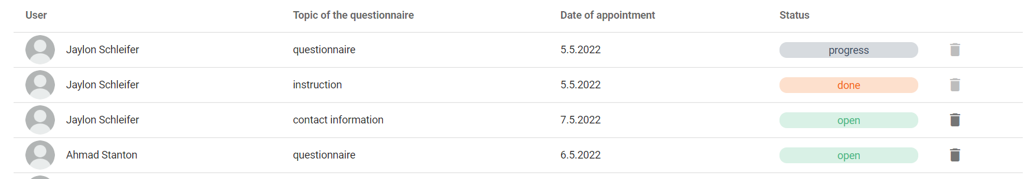
Page ‘Users List’
The page contains a table of users, which shows all questionnaires assigned to all users. Table cells contain information about questionnaires:
the name of the user to whom the questionnaire is assigned,
questionnaire title
appointment date,
passing status,
the ability to delete a questionnaire that has not been started.

Slide 4

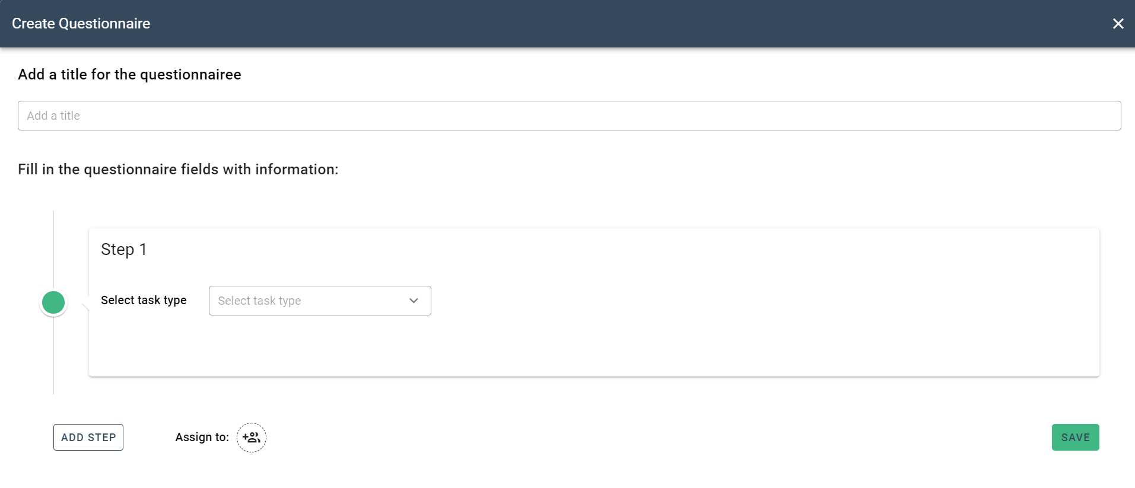
Page ‘Users List’
It is also possible to create a new questionnaire. This can be done by clicking on the button ‘Add questionnaire’.
By clicking on the button, the questionnaire creation page will open in a dialog box.

Slide 5
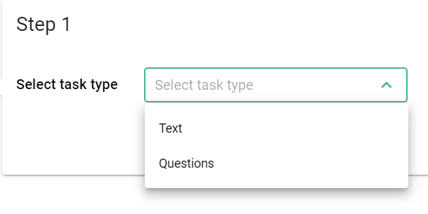
Page ‘Create Questionnaire’
On this page you need to enter a name for the questionnaire.
Then you need to create a questionnaire. The questionnaire may have several steps. At each step, you need to select the type of task. This may be a text to read or a question that the user will have to answer.

Slide 6
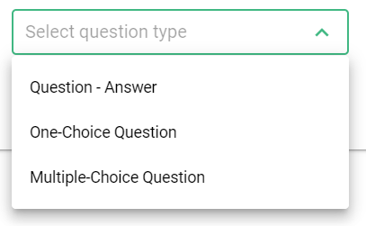

Page ‘Create Questionnaire’
If you select the task type "question" you need to fill out a form. Write a question and choose the type of answer options. This can be a text response from the user or a selection from given options.
When choosing an answer type with given options, you need to write the answer options. You can increase the number of answer options by clicking on the button “Add answer”.

Slide 7



Page ‘Create Questionnaire’
You can add another question by clicking on the button “Add question”.
Or delete one of the questions by clicking on the button
You can add another step of the questionnaire by clicking on the button “Add step”.

Slide 8



Page ‘Create Questionnaire’
You also need to select a user, one or more, to whom this questionnaire will be assigned.
Confirm the entered data by clicking on the button “Save”.
You can exit the questionnaire by clicking on the button in the upper right corner

Slide 9
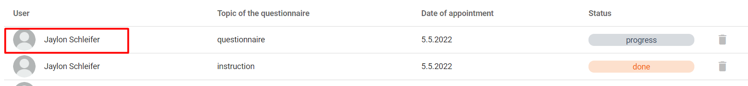
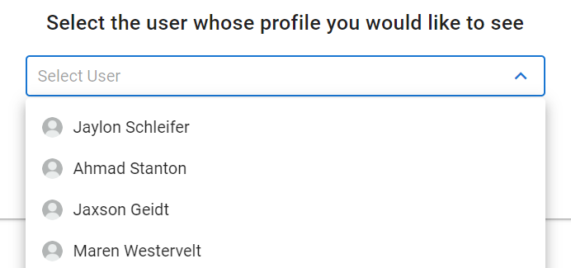
Page ‘User Profile’
To view the profile of any user, you can click on the table cell
Or select "User Profile" from the menu on the left. When you select the " User Profile " menu item, a page will open where you need to select a user from the list and confirm your choice.

Slide 10
Page ‘User Profile’
The user profile page contains information about the user (block on the left) and information about the questionnaires that the user has been assigned (block on the right).
Information about the questionnaires is presented in the form of a table that contains the following information:
questionnaire title,
appointment date,
date of completion of the questionnaire,
passing status.
The tabs above the table allow you to sort questionnaires by status.

Slide 11
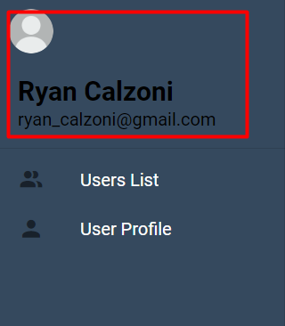
Page ‘User Profile’
You can view your profile by clicking on your picture or your name in the navigation bar on the left.

Slide 12
Thank you for taking the time to my project.
By Tatsiana Zuyevich

